Slide 1
computational graph web application
Advanced Programming, Course Number 848367701.
Omer Sela ID: 316539535
Ahigad Genish ID: 316228022

Slide 2
About the Project
This project simulates complex mechanisms through exercises, culminating in a complete system. It involves implementing design patterns, a generic server with servlets (java client end-points) using the publisher/subscriber architecture to create a computational graph for complex calculations, present the graph to user and shows the graph result.
Project Phases:
Build infrastructure for the computational graph (Model layer).
Create a code library for a RESTFUL API server (Controller layer).
Develop a network application to load and run computational graphs via a browser (View layer).

Slide 3
Overview
We will divide the project into 3 logical layers.
Model:
The graph model consists of an Agent interface defining agent structures, BinOpAgent and UnOpAgent for binary and unary operations respectively, a Graph class managing nodes and edges, and a Message class defining the structure of messages passed between topics. The HTML components include a form section for file uploads and expression inputs, a topic input form for injecting input into variables, a graph display section showing the computational graph visually with nodes and edges, and a results display section with a dynamically updated results table.
Server:
The server side is a RESTful API implemented from scratch in Java.
The server includes various servlets:
ConfLoader (POST /upload) for handling configuration file uploads,
ExpressionHandler (POST /uploadExpression) for processing expressions,
HtmlLoader (GET /app) for serving HTML files,
ResultHandler (GET /result) for fetching computation results,
TopicDisplayer (GET /publish) for displaying and updating topic messages.
The Computational Graph Server project implements a server that provides an interface for uploading configuration files or mathematical expressions, managing topics and agents, and displaying the resulting computational graph.
Client (View):
The client side features a main page with sections for uploading files, entering mathematical expressions, displaying the graph, and showing topic messages and graph results.
The app can be accessed via a browser at http://localhost:8080/app. The interface uses responsive HTML and CSS for optimal viewing and JavaScript to handle file uploads, parsing, topic management, and result fetching that obtained by polling requests from the server.

Slide 4
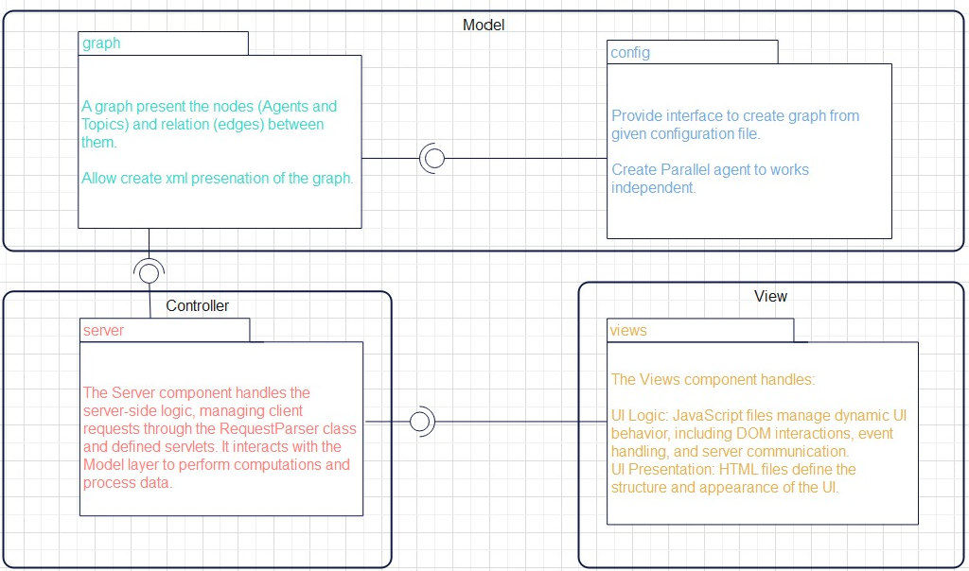
Component Design Diagram

Slide 5
For a video that demos an example of using the computational graph web application, click on the link:
Google Drive Link

Slide 6
About Advanced Programming Course
Throughout “Advanced Programming” course, we gained a deep understanding of essential programming principles and best practices, such as SOLID and GRASP, which will enhance our software design skills.
The hands-on experience with Java, particularly in implementing data structures, file handling, and network communication, has solidified our coding proficiency.
Learning about advanced architectural patterns like MVC and MVVM has provided us the tools to create well-structured and maintainable applications.
Additionally, the practical experience with web development with an introduction to RESTful services and scalability concepts, has prepared us to build robust and scalable network applications.
Finally this comprehensive course has equipped me with a versatile skill set that I will carry forward in my programming career.

